Slide 1
Matrix-Vector Product
李宏毅
Hung-yi Lee

Slide 2

$$x_{1}$$
Linear
System
$$b_{1}$$
$$x_{2}$$
$$b_{2}$$
……
……
$$x_{n}$$
$$b_{m}$$
Matrix-vector product:

Slide 3
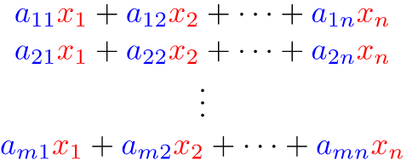
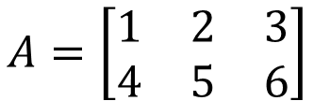

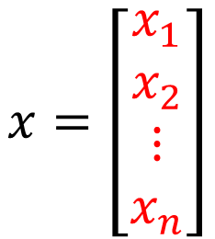

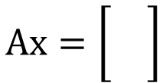
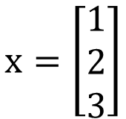
Row Aspect
$$A=\left[\begin{matrix}\begin{matrix}a_{11} & a_{12} \\ a_{21} & a_{22}\end{matrix} & \begin{matrix}⋯ & a_{1n} \\ ⋯ & a_{2n}\end{matrix} \\ \begin{matrix}⋮ & ⋮ \\ a_{m1} & a_{m2}\end{matrix} & \begin{matrix}⋱ & ⋮ \\ ⋯ & a_{mn}\end{matrix}\end{matrix}\right]$$
$$x=\left[\begin{matrix}\begin{matrix}x_{1} \\ x_{2}\end{matrix} \\ \begin{matrix}⋮ \\ x_{n}\end{matrix}\end{matrix}\right]$$
$$Ax=$$
$$x=\left[\begin{matrix}1 \\ 2 \\ 3\end{matrix}\right]$$
$$A=\left[\begin{matrix}1 & 2 & 3 \\ 4 & 5 & 6\end{matrix}\right]$$
$$Ax=\left[\begin{matrix} \\ \end{matrix}\right]$$
Notes:
每一行的A都和x做内积

Slide 4

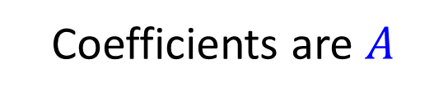




Matrix-Vector Product
$$Ax$$
$$=$$
$$b$$
Linear System
$$x$$
$$Ax$$
Coefficients are $A$

Slide 5
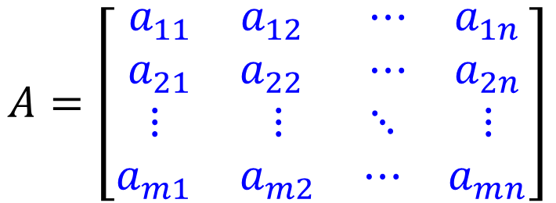
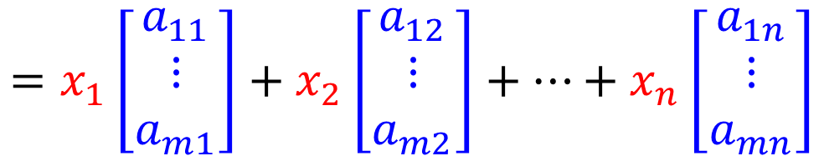



Column Aspect
$$A=\left[\begin{matrix}\begin{matrix}a_{11} & a_{12} \\ a_{21} & a_{22}\end{matrix} & \begin{matrix}⋯ & a_{1n} \\ ⋯ & a_{2n}\end{matrix} \\ \begin{matrix}⋮ & ⋮ \\ a_{m1} & a_{m2}\end{matrix} & \begin{matrix}⋱ & ⋮ \\ ⋯ & a_{mn}\end{matrix}\end{matrix}\right]$$
$$x=\left[\begin{matrix}\begin{matrix}x_{1} \\ x_{2}\end{matrix} \\ \begin{matrix}⋮ \\ x_{n}\end{matrix}\end{matrix}\right]$$
$$=x_{1}\left[\begin{matrix}a_{11} \\ ⋮ \\ a_{m1}\end{matrix}\right]+x_{2}\left[\begin{matrix}a_{12} \\ ⋮ \\ a_{m2}\end{matrix}\right]+…+x_{n}\left[\begin{matrix}a_{1n} \\ ⋮ \\ a_{mn}\end{matrix}\right]$$
$$Ax$$
$$=$$
Notes:
Linear combination of columns of A whose coefficients are the components in x

Slide 6















Example
$$A=\left[\begin{matrix}1 & 4 \\ −3 & 2\end{matrix}\right]$$
$$x_{1}+4x_{2}=b_{1}$$
-2
$$x_{1}$$
A
$$b_{1}$$
$$=Ax$$
$$−3x_{1}+2x_{2}=b_{2}$$
0.5
$$x_{2}$$
$$b_{2}$$
Row 1
$$\left[\begin{matrix}−2 \\ 6\end{matrix}\right]$$
Row 2
column 2
$$\left[\begin{matrix}1 \\ 4\end{matrix}\right]$$
$$\left[\begin{matrix}−3 \\ 2\end{matrix}\right]$$
$$\left[\begin{matrix}4 \\ 2\end{matrix}\right]$$
$$\left[\begin{matrix}2 \\ 1\end{matrix}\right]$$
$$\left[\begin{matrix}−2 \\ 0.5\end{matrix}\right]$$
Column
Aspect
Row
Aspect
$$\left[\begin{matrix}1 \\ −3\end{matrix}\right]$$
column 1
Notes:
$$从row的角度看\text{就是把向量和}矩阵的每一行分别做inner product\left[\begin{matrix}0 \\ 7\end{matrix}\right]$$
$$从column的角度看\text{就是把向量}每一个值（一个scalar）\text{和}矩阵对应的每一列分别相乘，最后得到的结果再相加$$

Slide 7




Matrix-vector Product
The size of matrix and vector should be matched.
$$A=\left[\begin{matrix}2 & 3 & 5 \\ 3 & 1 & −1 \\ −2 & 1 & 1\end{matrix}\right]$$
$$x=\left[\begin{matrix}1 \\ −1\end{matrix}\right]$$
$$A^{′′}=\left[\begin{matrix}\begin{matrix}2 \\ 3\end{matrix} & \begin{matrix}1 \\ 2\end{matrix} \\ \begin{matrix}0 \\ 1\end{matrix} & \begin{matrix}−1 \\ −3\end{matrix}\end{matrix}\right]$$
$$A′=\left[\begin{matrix}1 & −1 \\ 2 & 3 \\ 1 & 4\end{matrix}\right]$$

Slide 8
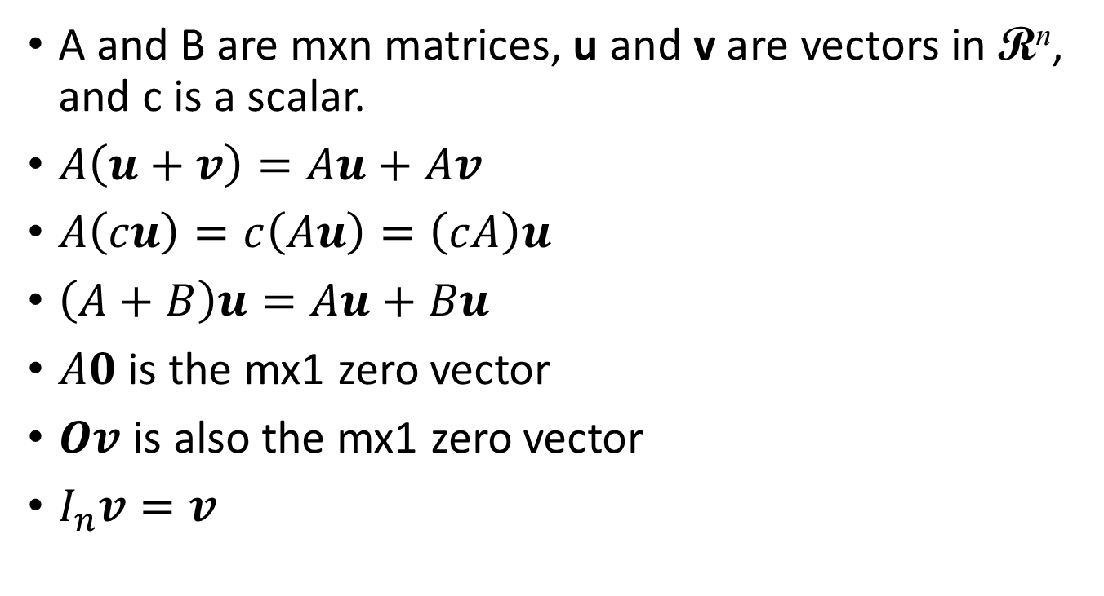
Properties of Matrix-vector Product
A and B are mxn matrices, u and v are vectors in R^{n}, and c is a scalar.
$A\left(u+v\right)=Au+Av$
$A\left(cu\right)=c\left(Au\right)=\left(cA\right)u$
$\left(A+B\right)u=Au+Bu$
$A0$ is the mx1 zero vector
$Ov$ is also the mx1 zero vector
$I_{n}v=v$
Notes:
The last one can say something.

Slide 9





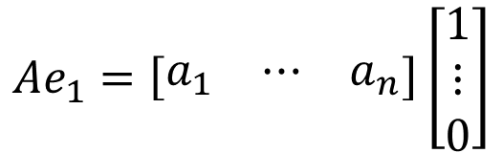






Properties of Matrix-vector Product
A and B are mxn matrices. If $Aw=Bw$ for all $w$ in R^{n}. Is it true that $A=B$?
$Ae_{j}=a_{j}$ for $j=1,2,⋯,n$, where $e_{j}$ is the j-th standard vector in R^{n}
$$e_{1}=\left[\begin{matrix}1 \\ ⋮ \\ 0\end{matrix}\right]$$
$$Ae_{1}=\left[\begin{matrix}a_{1} & ⋯ & a_{n}\end{matrix}\right]\left[\begin{matrix}1 \\ ⋮ \\ 0\end{matrix}\right]$$
Column Aspect
$$=1∙a_{1}+0∙a_{2}+⋯+0∙a_{n}$$
$$=a_{1}$$
$$Ae_{1}=Be_{1}$$
$$Ae_{2}=Be_{2}$$
$$Ae_{n}=Be_{n}$$
……
$$A=B$$
$$a_{1}=b_{1}$$
$$a_{2}=b_{2}$$
$$a_{n}=b_{n}$$
Notes:
http://betterexplained.com/articles/linear-algebra-guide/

Slide 10

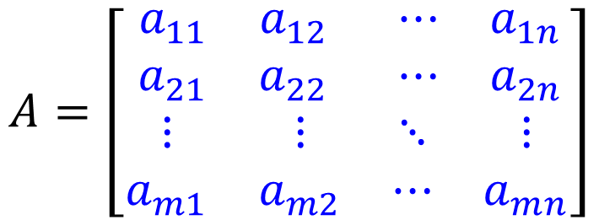


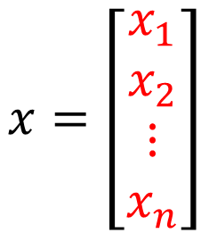
Concluding Remarks
$$A=\left[\begin{matrix}\begin{matrix}a_{11} & a_{12} \\ a_{21} & a_{22}\end{matrix} & \begin{matrix}⋯ & a_{1n} \\ ⋯ & a_{2n}\end{matrix} \\ \begin{matrix}⋮ & ⋮ \\ a_{m1} & a_{m2}\end{matrix} & \begin{matrix}⋱ & ⋮ \\ ⋯ & a_{mn}\end{matrix}\end{matrix}\right]$$
$$x=\left[\begin{matrix}\begin{matrix}x_{1} \\ x_{2}\end{matrix} \\ \begin{matrix}⋮ \\ x_{n}\end{matrix}\end{matrix}\right]$$
Row
Aspect
$$Ax$$
$$=$$
$$=x_{1}\left[\begin{matrix}a_{11} \\ ⋮ \\ a_{m1}\end{matrix}\right]+x_{2}\left[\begin{matrix}a_{12} \\ ⋮ \\ a_{m2}\end{matrix}\right]+…+x_{n}\left[\begin{matrix}a_{1n} \\ ⋮ \\ a_{mn}\end{matrix}\right]$$
Column
Aspect
Notes:
Matrix-vector Product Ax
Row Aspect
Inner project of x to each row of A
Column Aspect
The combination of columns of A
The elements in x is the coefficients

